Slide 1
Unit 6 Linear Classification & Logistic Regression
EE-uy 4563/EL-GY 9143: Introduction to machine learning
Prof. Sundeep rangan (with Modification by Yao Wang)

Slide 2
Learning Objectives
Formulate a machine learning problem as a classification problem
Identify features, class variable, training data
Visualize classification data using a scatter plot.
Describe a linear classifier as an equation and on a plot.
Determine visually if data is perfect linearly separable.
Formulate a classification problem using logistic regression
Binary and multi-class
Describe the logistic and soft-max function
Logistic function to approximate the probability
Derive the loss function for ML estimation of the weights in logistic regression
Use sklearn packages to fit logistic regression models
Measure the accuracy of classification
Adjust threshold of classifiers for trading off types of classification errors. Draw a ROC curve.
Perform LASSO regularization for feature selection

Slide 3
Outline
Motivating Example: Classifying a breast cancer test
Linear classifiers
Logistic regression
Fitting logistic regression models
Measuring accuracy in classification

Slide 4
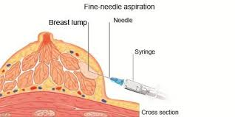
Diagnosing Breast Cancer
Fine needle aspiration of suspicious lumps
Cytopathologist visually inspects cells
Sample is stained and viewed under microscope
Determines if cells are benign or malignant
Also provides grading if malignant
Uses many features:
Size and shape of cells, degree of mitosis, differentiation, …
Diagnosis is not exact
If uncertain, use a more comprehensive biopsy
Additional cost and time
Stress to patient
Can machine learning provide better rules?
Grades of carcinoma cells
http://breast-cancer.ca/5a-types/

Slide 5
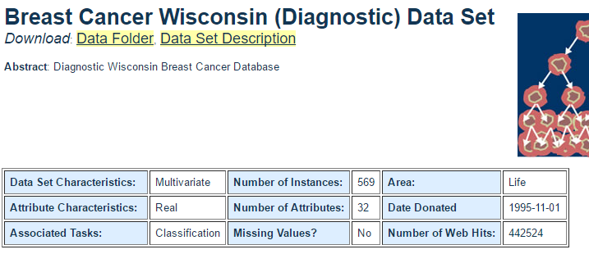
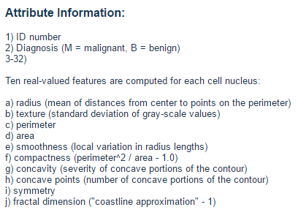
Data
Univ. Wisconsin study, 1994
569 samples
10 visual features for each sample
Ground truth determined by biopsy
First publication: O.L. Mangasarian, W.N. Street and W.H. Wolberg. Breast cancer diagnosis and prognosis via linear programming. Operations Research, 43(4), pages 570-577, July-August 1995.

Slide 6
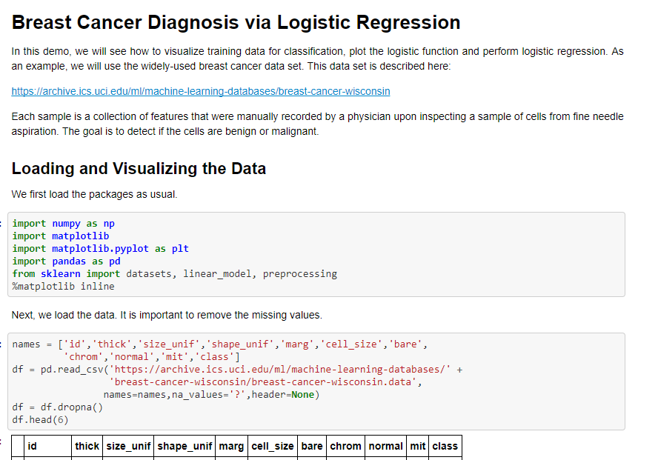
Demo on Github
Github: https://github.com/sdrangan/introml/blob/master/logistic/breast_cancer.ipynb

Slide 7
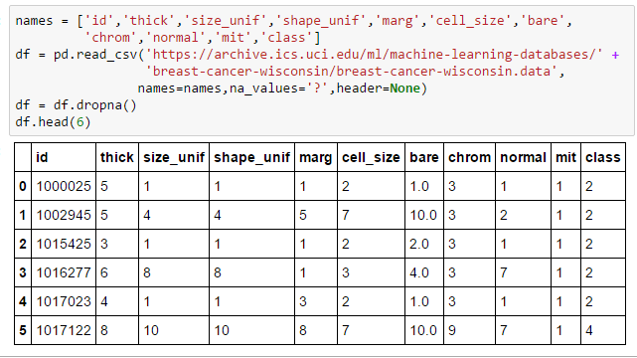
Loading The Data
Follow standard pandas routine
All code in Lect06_Demo.ipynb
Drops missing samples
Class = 2 => benign
Class = 4 => malignant
See following for explanation of attributes
https://archive.ics.uci.edu/ml/machine-learning-databases/breast-cancer-wisconsin/breast-cancer-wisconsin.names

Slide 8
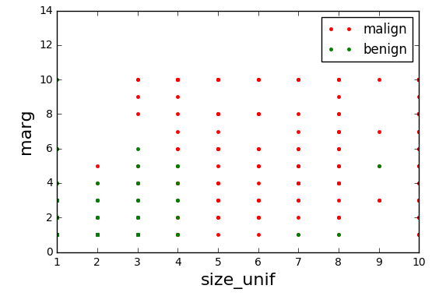
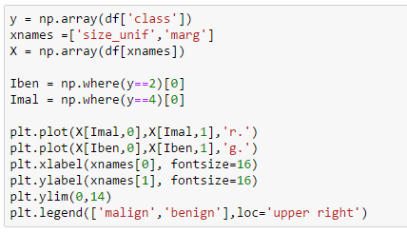
Visualizing the Data
Scatter plot of points from each class
Plot not informative
Many points overlap
Relative frequency at each point not visible

Slide 9
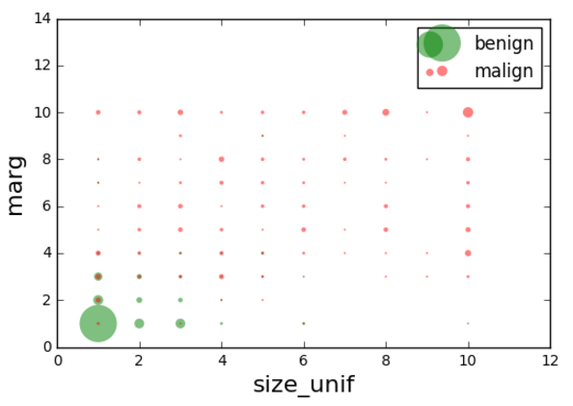
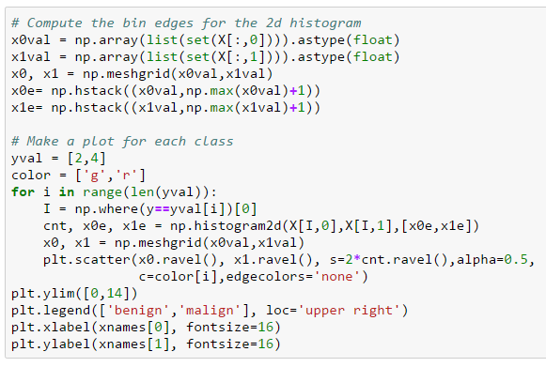
Improving the Plot
Make circle size proportional to count
Many gymnastics to make this plot in python

Slide 10
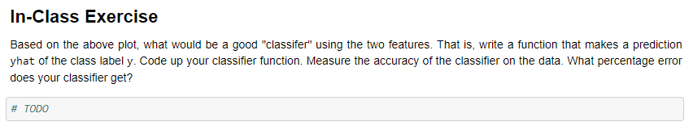
In-Class Exercise
Get into groups
At least one must have a laptop with jupyter notebook
Determine a classification rule
Predict class label from the two features
Test in python
Make the predictions
Measure the accuracy

Slide 11
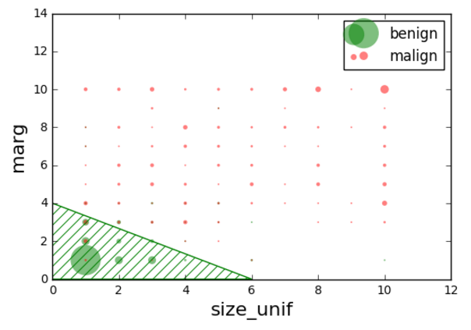
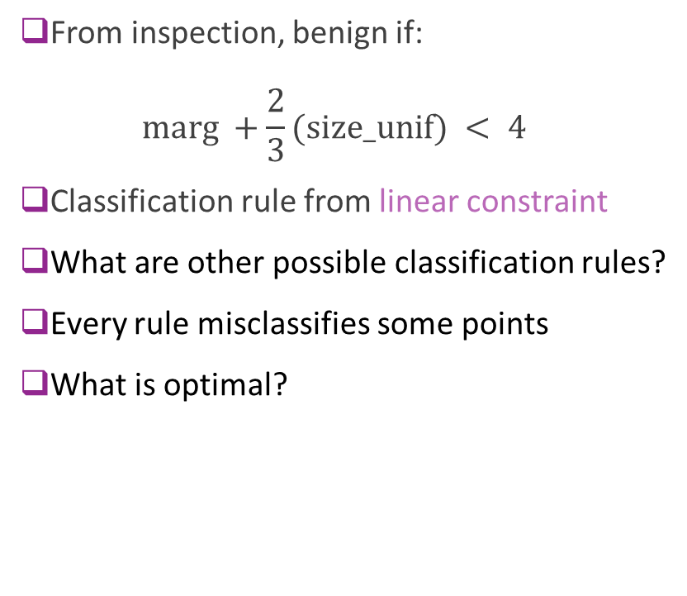
A Possible Classification Rule
From inspection, benign if: $\text{marg} +\frac{2}{3}(\text{size}\text{_}\text{unif}) < 4$
Classification rule from linear constraint
What are other possible classification rules?
Every rule misclassifies some points
What is optimal?

Slide 12
Mangasarian’s Original Paper
Proposes Multisurface method – Tree (MSM-T)
Decision tree based on linear rules in each step
Fig to left from
Pantel, “Breast Cancer Diagnosis and Prognosis,” 1995
Best methods today use neural networks
This lecture will look at linear classifiers
These are much simpler
Do not provide same level of accuracy
But, building block to more complex classifiers

Slide 13
Outline
Motivating Example: Classifying a breast cancer test
Linear classifiers
Logistic regression
Fitting logistic regression models
Measuring accuracy in classification

Slide 14
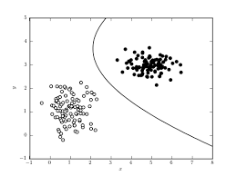
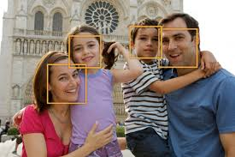
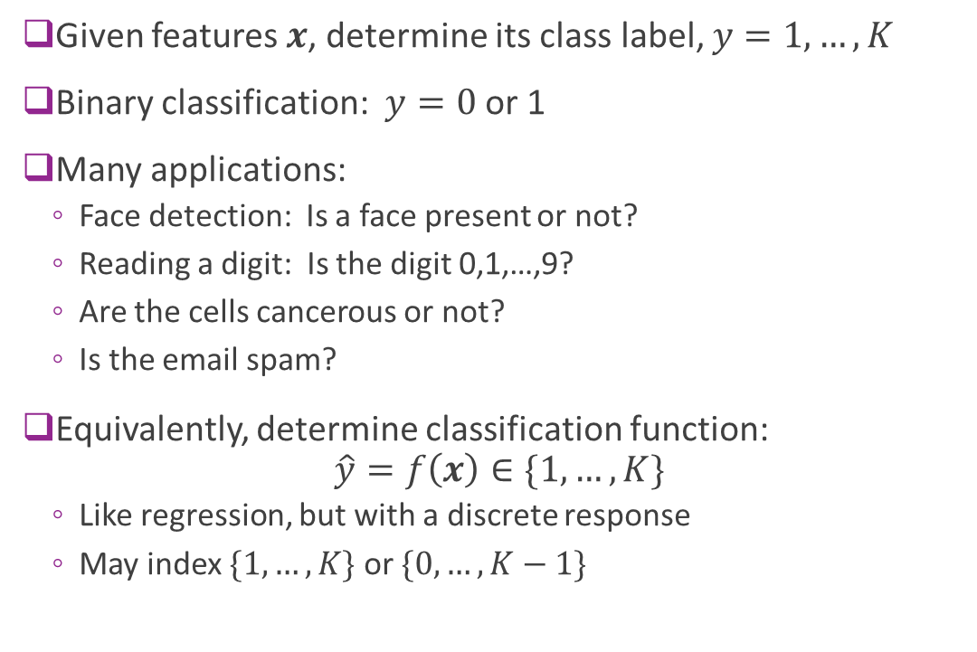
Classification
Given features $x$, determine its class label, $y=1,…,K$
Binary classification: $y=0$or 1
Many applications:
Face detection: Is a face present or not?
Reading a digit: Is the digit 0,1,…,9?
Are the cells cancerous or not?
Is the email spam?
Equivalently, determine classification function: $\hat{y}=f\left(x\right)∈\{1,…,K\}$
Like regression, but with a discrete response
May index $\{1,…,K\}$ or $\{0,…,K−1\}$

Slide 15
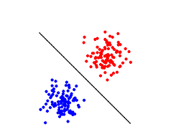
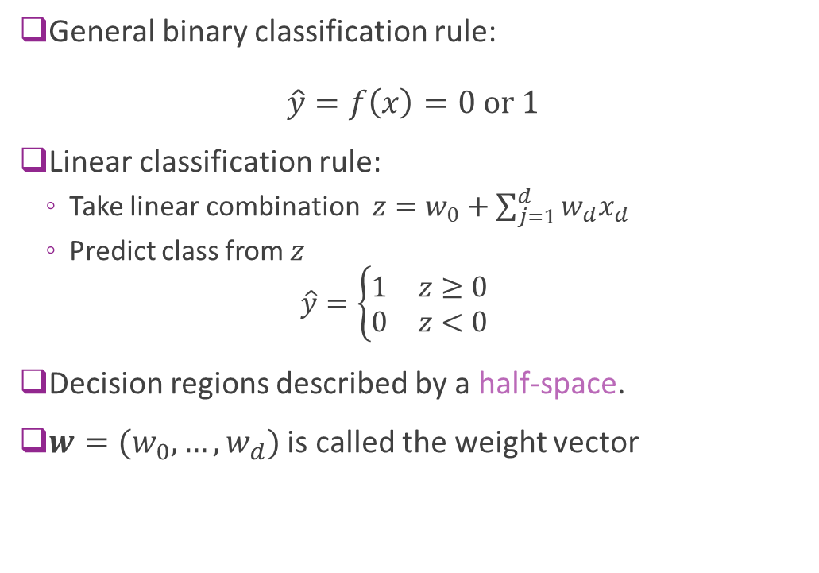
Linear Classifier
General binary classification rule: $\hat{y}=f\left(x\right)=0 \text{or} 1$
Linear classification rule:
Take linear combination $z=w_{0}+\sum_{j=1}^{d}{{w_{d}x}_{d}}$
Predict class from $z$ $\hat{y}=\left\{\begin{matrix}1 & z≥0 \\ 0 & z<0\end{matrix}\right.$
Decision regions described by a half-space.
$w=(w_{0},…,w_{d})$ is called the weight vector

Slide 16
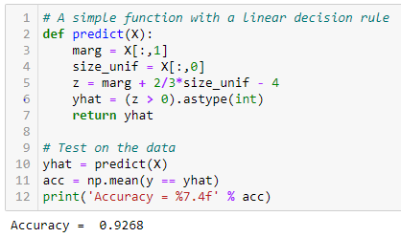
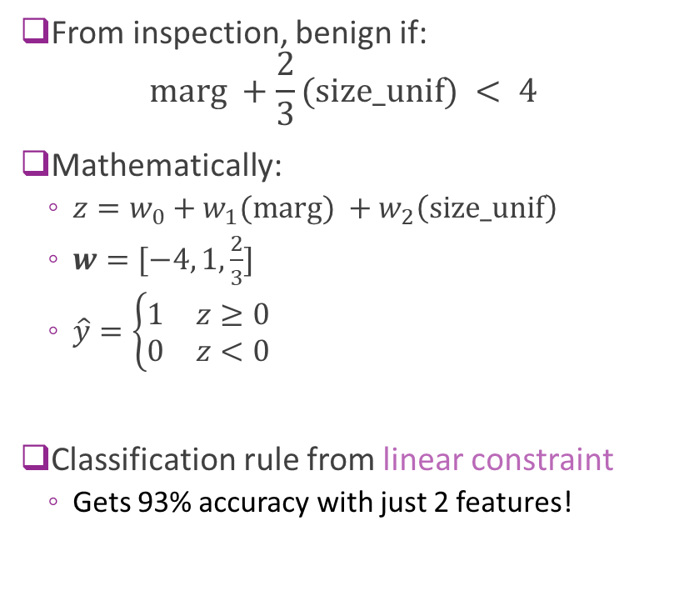
Breast Cancer Example
From inspection, benign if: $\text{marg} +\frac{2}{3}(\text{size}\text{_}\text{unif}) < 4$
Mathematically:
$z=w_{0}+w_{1}(\text{marg}\text{)} +w_{2}\left(\text{size}\text{_}\text{unif}\right)$
$w=[−4, 1,\frac{2}{3}]$
$\hat{y}=\left\{\begin{matrix}1 & z≥0 \\ 0 & z<0\end{matrix}\right.$
Classification rule from linear constraint
Gets 93% accuracy with just 2 features!

Slide 17
Breast Cancer Example
Questions for today:
How do we use all 10 features?
How do we fit an optimal linear classifier?
What is optimal?

Slide 18
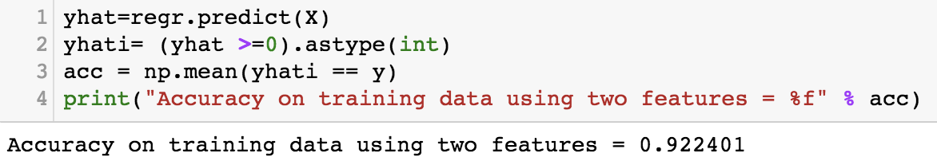
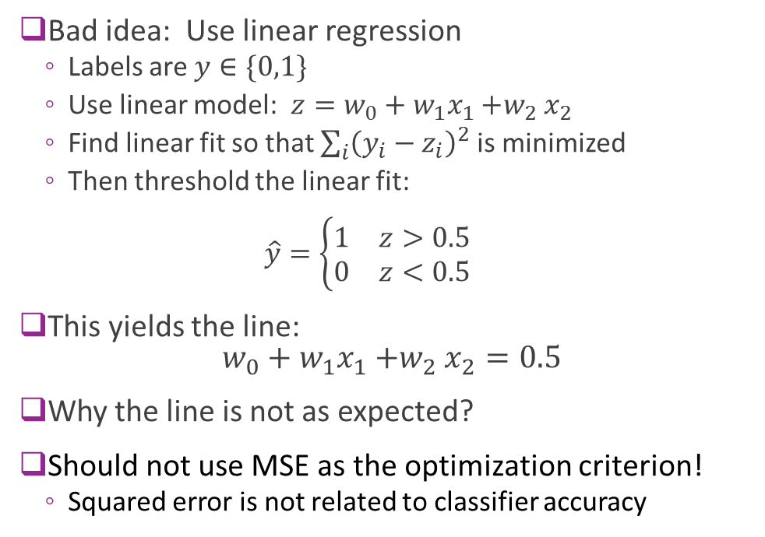
Using Linear Regression on Two Features
Bad idea: Use linear regression
Labels are $y∈\{0,1\}$
Use linear model: $z=w_{0}+w_{1}x_{1}{+w}_{2}x_{2}$
Find linear fit so that $\sum_{i}{{\left(y_{i}−z_{i}\right)}^{2}}$ is minimized
Then threshold the linear fit: $\hat{y}=\left\{\begin{matrix}1 & z>0.5 \\ 0 & z<0.5\end{matrix}\right.$
This yields the line: $w_{0}+w_{1}x_{1}{+w}_{2}x_{2}=0.5$
Why the line is not as expected?
Should not use MSE as the optimization criterion!
Squared error is not related to classifier accuracy

Slide 19
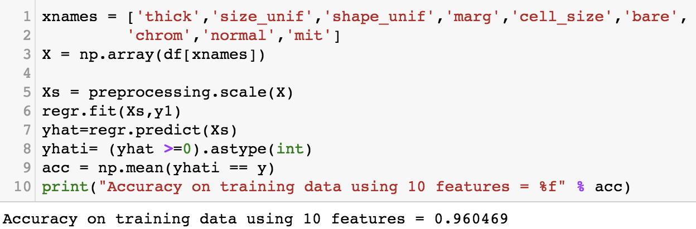
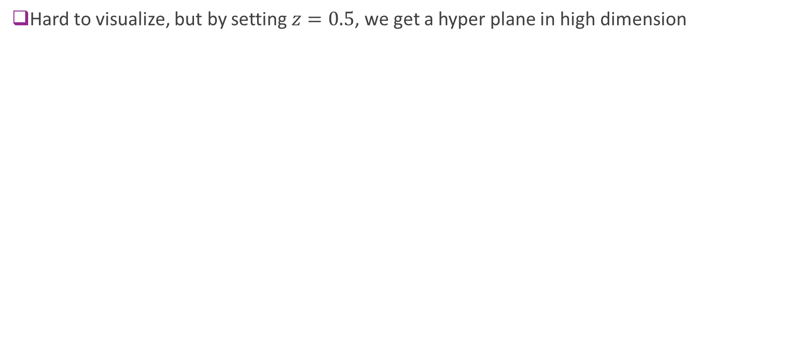
Using linear classifier on all features
Hard to visualize, but by setting $z=0.5$, we get a hyper plane in high dimension

Slide 20
Go through the demo
Up to linear regression

Slide 21
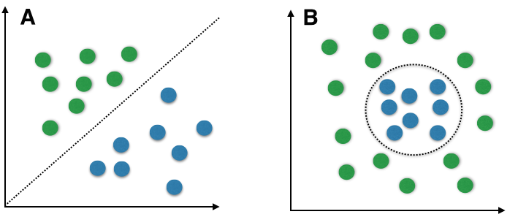
Linear vs. Non-Linear
Linear boundaries are limited
Can only describe very simple regions
But, serves as building block
Many classifiers use linear rules as first step
Neural networks, decision trees, …
Breast cancer example:
Is the region linear or non-linear?

Slide 22

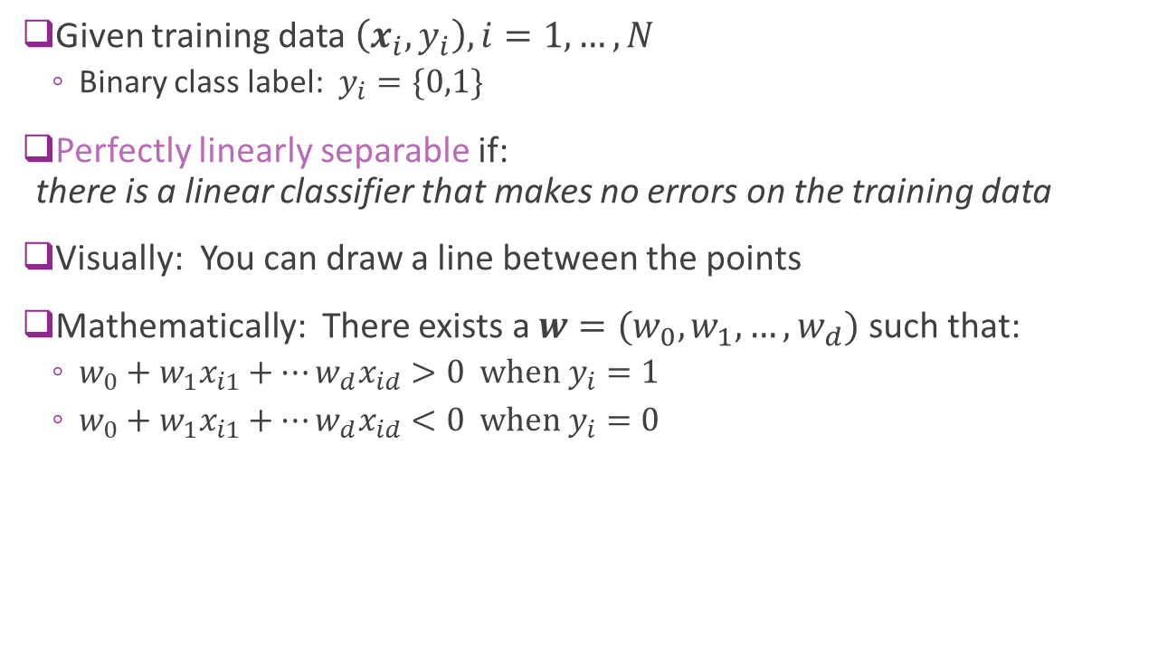
Perfect Linear Separability
Given training data $\left(x_{i},y_{i}\right), i=1,…,N$
Binary class label: $y_{i}=\{0,1\}$
Perfectly linearly separable if: there is a linear classifier that makes no errors on the training data
Visually: You can draw a line between the points
Mathematically: There exists a $w=(w_{0},w_{1},…,w_{d})$ such that:
$w_{0}+w_{1}x_{i1}+⋯w_{d}x_{id}>0 \text{when} y_{i}=1$
$w_{0}+w_{1}x_{i1}+⋯w_{d}x_{id}<0 \text{when} y_{i}=0$
$$w$$

Slide 23
Most Data not Perfectly Separable
Generally cannot find a separating hyperplane
Always, some points that will be mis-classified
Algorithms attempt to find “good” hyper-planes
Reduce the number of mis-classified points
Or, some similar metric

Slide 24
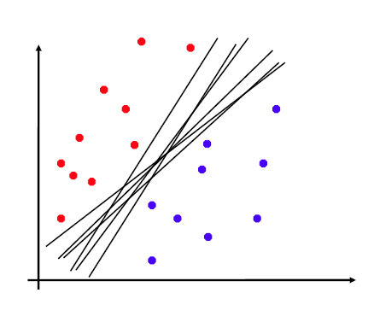
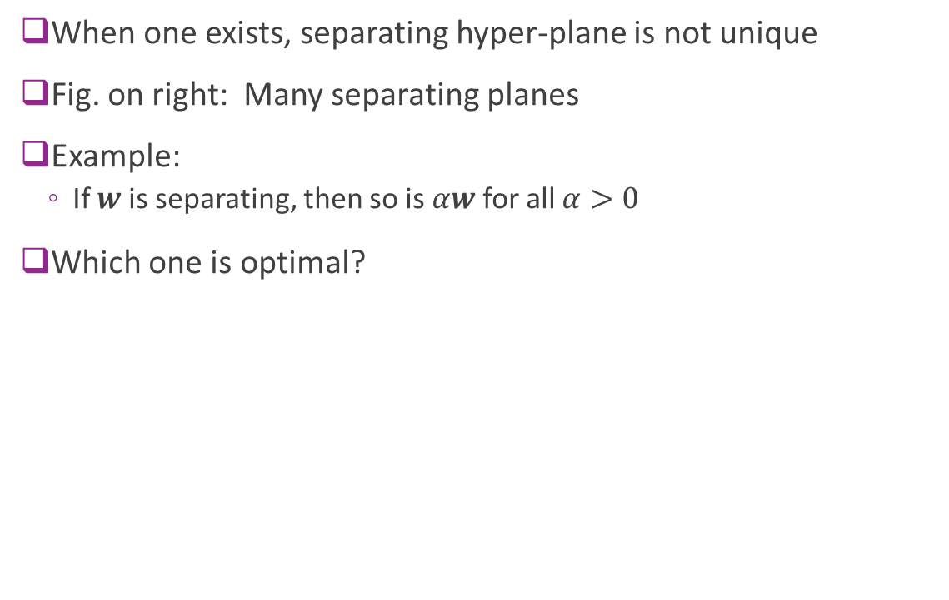
Non-Uniqueness
When one exists, separating hyper-plane is not unique
Fig. on right: Many separating planes
Example:
If $w$ is separating, then so is $αw$ for all $α>0$
Which one is optimal?

Slide 25
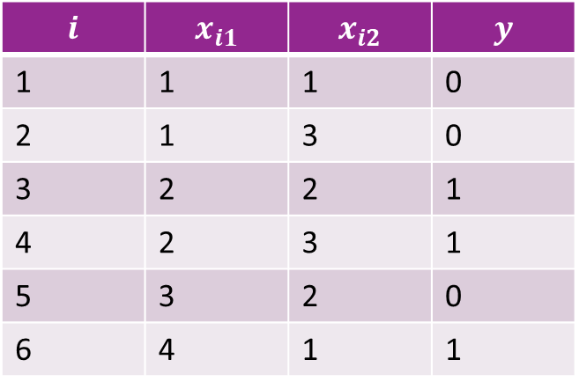
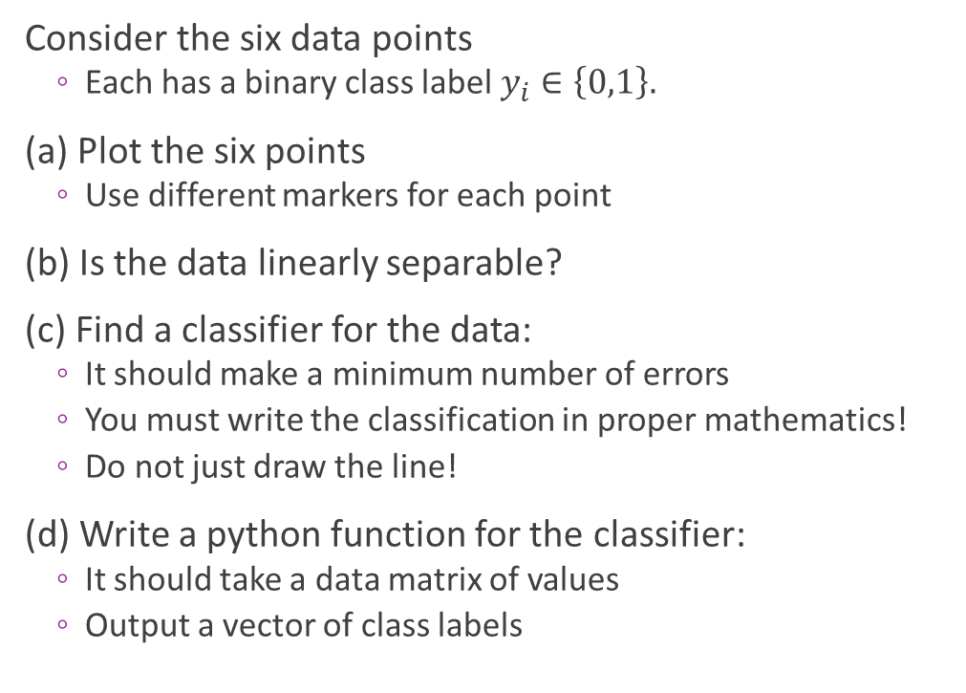
Sample Problem
Consider the six data points
Each has a binary class label $y_{i}∈\left\{0,1\right\}.$
(a) Plot the six points
Use different markers for each point
(b) Is the data linearly separable?
(c) Find a classifier for the data:
It should make a minimum number of errors
You must write the classification in proper mathematics!
Do not just draw the line!
(d) Write a python function for the classifier:
It should take a data matrix of values
Output a vector of class labels
$$i$$ | $$x_{i1}$$ | $$x_{i2}$$ | $$y$$
1 | 1 | 1 | 0
2 | 1 | 3 | 0
3 | 2 | 2 | 1
4 | 2 | 3 | 1
5 | 3 | 2 | 0
6 | 4 | 1 | 1

Slide 26
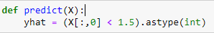
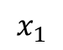
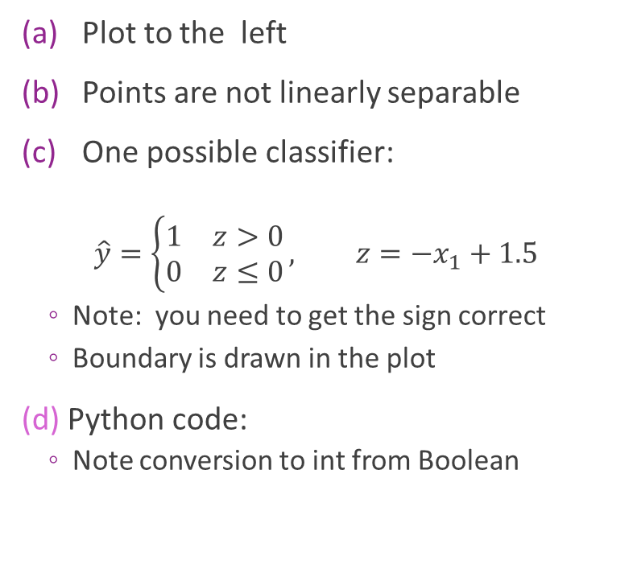
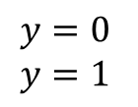
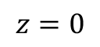
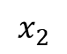
Solution
$$y=0 \\ y=1$$
Plot to the left
Points are not linearly separable
One possible classifier:
$$\hat{y}=\left\{\begin{matrix}1 & z>0 \\ 0 & z≤0\end{matrix}\right., z=−x_{1}+1.5$$
Note: you need to get the sign correct
Boundary is drawn in the plot
(d) Python code:
Note conversion to int from Boolean
$$x_{2}$$
3
2
1
0
$$x_{1}$$
1 2 3 4
$$z=0$$

Slide 27
Outline
Motivating Example: Classifying a breast cancer test
Linear classifiers
Logistic regression
Fitting logistic regression models
Measuring accuracy in classification

Slide 28

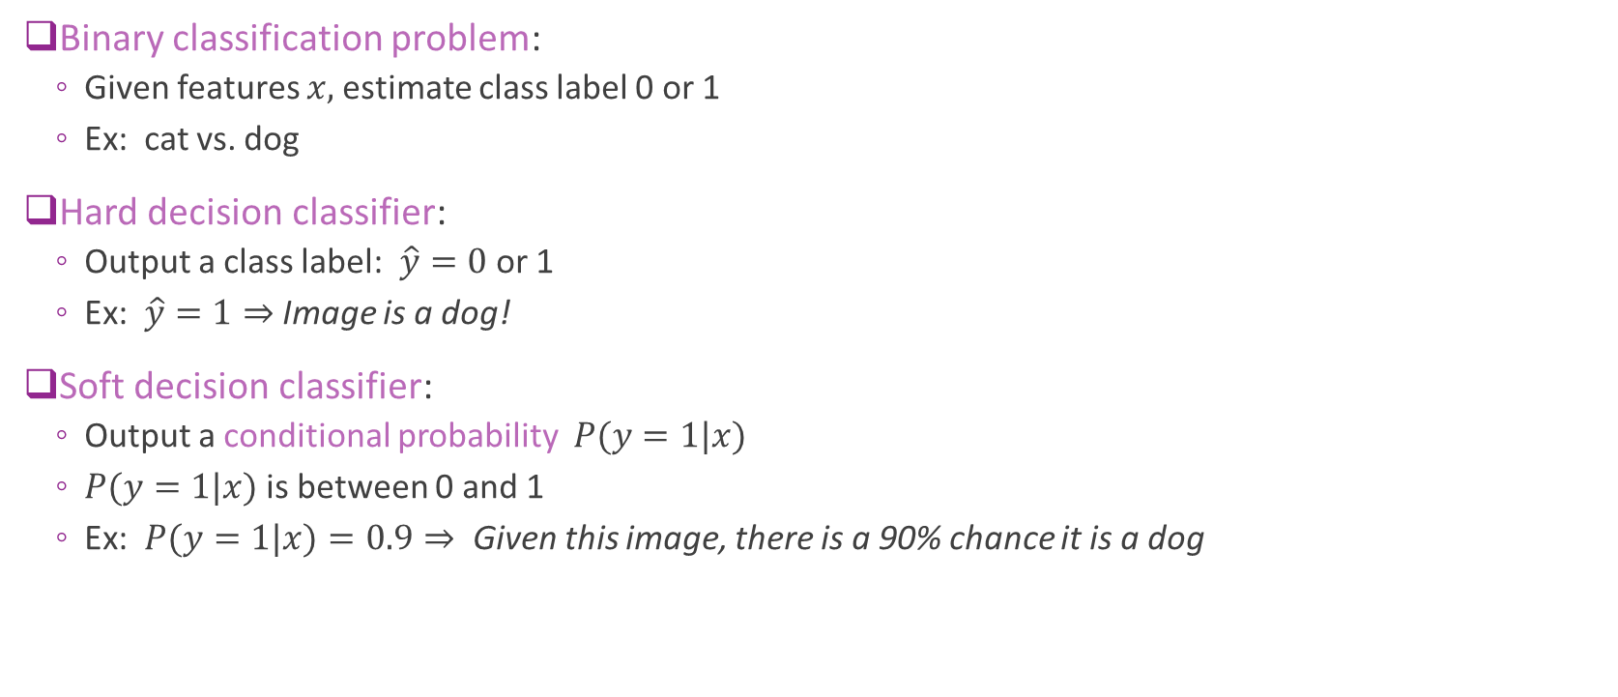
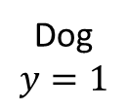
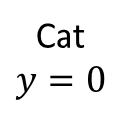
Hard vs. Soft Decision Classifiers
Binary classification problem:
Given features $x,$estimate class label 0 or 1
Ex: cat vs. dog
Hard decision classifier:
Output a class label: $\hat{y}=0$or 1
Ex: $\hat{y}=1⇒$ Image is a dog!
Soft decision classifier:
Output a conditional probability $P(y=1|x)$
$P(y=1|x)$is between 0 and 1
Ex: $P(y=1|x)=0.9⇒$Given this image, there is a 90% chance it is a dog
Cat
$$y=0$$
Dog
$$y=1$$

Slide 29

Why Use Soft Decision Classifiers?
In most problems, classifiers make errors
Example: Is the digit a 5 or 6?
Hard decision makes decision with certainty
But the decision can be wrong
Soft decision classifiers recognize this uncertainty
Easier to train soft decision classifier
Allows for error in training data
See next section
Provides a confidence measure
Example from MNIST dataset
True digit = 5
Hard decision
Digit = 6!
Soft decision
Digit = 5 with probability 30%
Digit = 6 with probability 70%

Slide 30
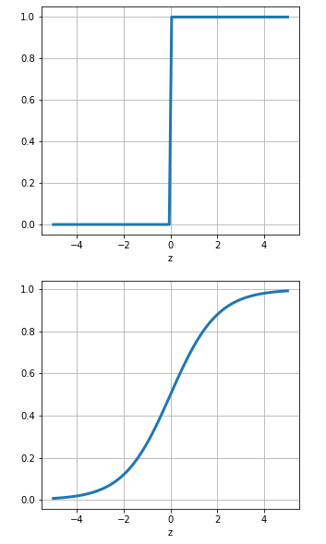
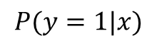
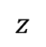
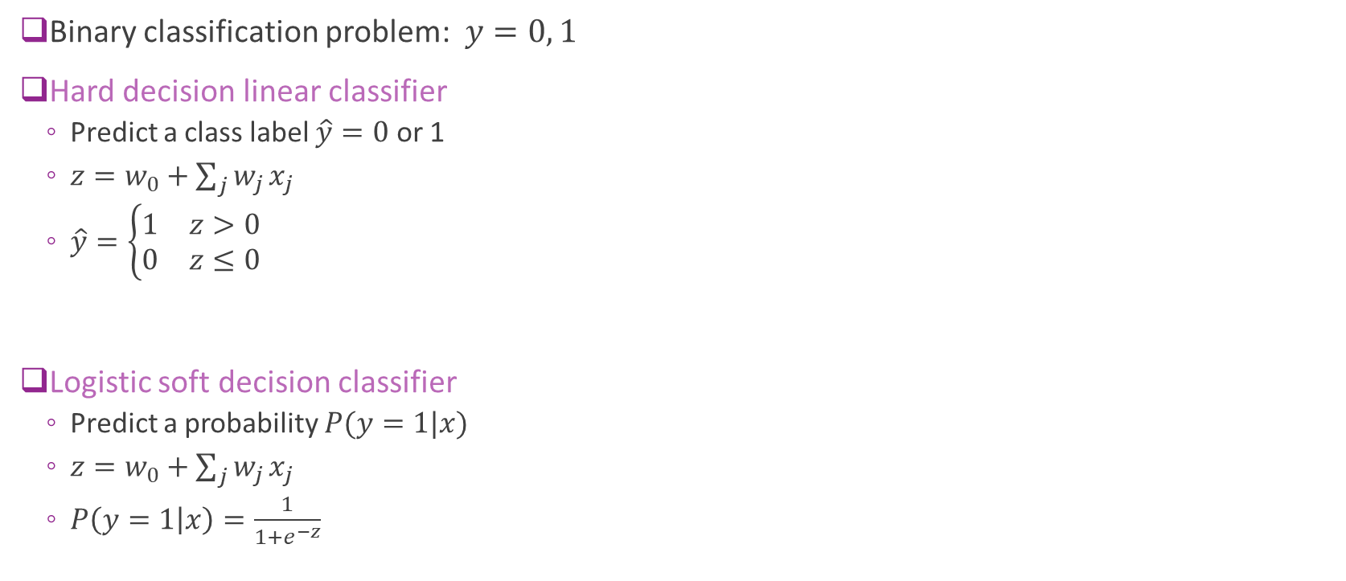
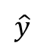
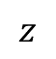
Logistic Model for Binary Classification
Binary classification problem: $y=0, 1$
Hard decision linear classifier
Predict a class label $\hat{y}=0$ or 1
$z=w_{0}+\sum_{j}{w_{j}}x_{j}$
$\hat{y}=\left\{\begin{matrix}1 & z>0 \\ 0 & z≤0\end{matrix}\right.$
Logistic soft decision classifier
Predict a probability $P(y=1|x)$
$z=w_{0}+\sum_{j}{w_{j}}x_{j}$
$P\left(y=1 | x\right)=\frac{1}{1+e^{−z}}$
$$\hat{y}$$
$$z$$
$$P(y=1|x)$$
$$z$$

Slide 31
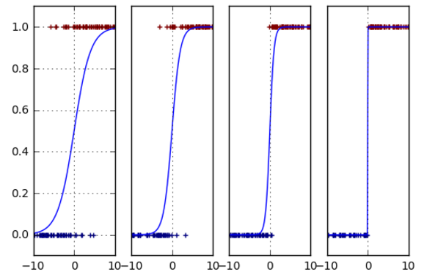
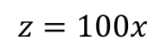
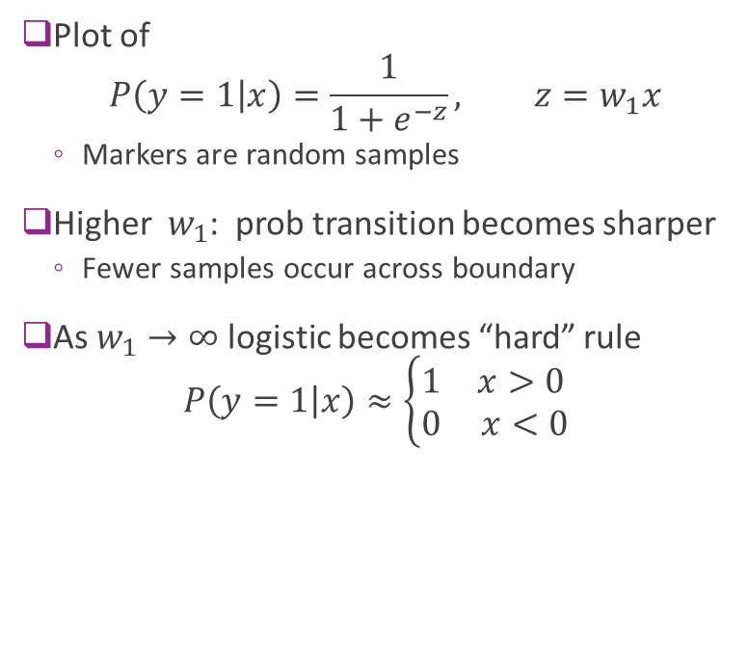
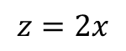
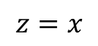
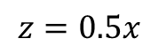
Logistic Model as a “Soft” Classifier
Plot of $P\left(y=1 | x\right)=\frac{1}{1+e^{−z}}, z=w_{1}x$
Markers are random samples
Higher $w_{1}$: prob transition becomes sharper
Fewer samples occur across boundary
As $w_{1}→∞$ logistic becomes “hard” rule $P\left(y=1 | x\right)≈\left\{\begin{matrix}1 & x>0 \\ 0 & x<0\end{matrix}\right.$
$$z=0.5x$$
$$z=x$$
$$z=2x$$
$$z=100x$$

Slide 32

Hard vs. Soft Classification in 2D
Hard decision:
Divides space into two half-space
One for each class label
Soft decision
Gradual transition for probability 0 to 1

Slide 33

Multi-Class Logistic Regression
Logistic regression easily extended to multiple classes
Suppose $y∈1,…,K$
$K$ possible classes (e.g. digits, letters, spoken words, …)
Two parameters: $W∈R^{K×d}, w_{0}∈R^{K}$ Slope matrix and bias
Step 1: Create $K$ linear functions. $z=Wx+w_{0}$
Called scores or logits
Step 2: Predict probabilities via softmax function
$$P\left(y=k | x\right)=\frac{e^{z_{k}}}{\sum_{ℓ=1}^{K}{e^{z_{ℓ}}}}$$

Slide 34


Softmax Example
Suppose:
Three class $y∈\{0,1,2\}$
For some $x$, the logits are $z=\left[−1, 0, 2\right]$
Then $\exp\left(z\right)=\left[0.36, 1, 7.36\right]$
Softmax probabilities:
$P\left(y=0 | x\right)=\frac{0.36}{0.36+1+7.36}≈0.042$
$P\left(y=1 | x\right)=\frac{1}{0.36+1+7.36}≈0.114$
$P\left(y=2 | x\right)=\frac{7.36}{0.36+1+7.36}≈0.844$
Probability
Class label

Slide 35

Softmax Properties
Consider soft-max function: $g_{k}\left(z\right)=\frac{e^{z_{k}}}{\sum_{ℓ=1}^{K}{e^{z_{ℓ}}}}$
$K$ inputs $z=\left(z_{1},…, z_{K}\right)$
$K$ outputs $g(z)=({g(z)}_{1},…, {g(z)}_{K})$
$g\left(z\right)$ is like a PMF on the labels $[0,1,…, K−1]$
$g_{k}\left(z\right)∈[0,1]$ for each component $k$
$\sum_{k=1}^{K}{g_{k}\left(z\right)}=1$
Softmax property: When $z_{k}≫z_{ℓ}$ for all $ℓ≠k$:
$g_{k}\left(z\right)≈1$
$g_{ℓ}\left(z\right)≈0 \text{for} \text{all} ℓ≠k$
Assigns highest probability to class $k$ when $z_{k}$ is largest
Probability
Class label

Slide 36

Multi-Class Logistic Regression Decision Regions
Each decision region defined by set of hyperplanes
Intersection of linear constraints
Sometimes called a polytope

Slide 37

Transform Linear Models
As in regression, logistic models can be applied to transform features
Step 1: Map $x$ to some transform features, $φ\left(x\right)={\left[φ_{1}\left(x\right),…,φ_{p}\left(x\right)\right]}^{T}$
Step 2: Linear weights: $z_{k}=\sum_{j=1}^{p}{{W_{kj}φ}_{j}\left(x\right)}$
Step 3: Soft-max $P\left(y=k | z\right)=g_{k}\left(z\right), g_{k}\left(z\right)=\frac{e^{z_{k}}}{\sum_{ℓ}{e^{z_{ℓ}}}}$
Example transforms:
Standard regression $φ\left(x\right)={\left[1,x_{1},…, x_{j}\right]}^{T}$ ($j$ original features, j$+1$ transformed features)
Polynomial regression: $φ\left(x\right)={\left[1,x,…, x^{d}\right]}^{T}$ ($1$ original feature, $d+1$ transformed features)
Additional transform step

Slide 38

Using Transformed Features
Enables richer class boundaries
Example: Fig B is not linearly separable
But, consider nonlinear features
$φ\left(x\right)={\left[1,x_{1},x_{2},x_{1}^{2},x_{2}^{2}\right]}^{T}$
Then can discriminate classes with linear function
$w=\left[{−r}^{2},0,0,1,1\right]$
$z=w^{T}φ\left(x\right)=x_{1}^{2}+x_{2}^{2}−r^{2}$
Blue when $z≤0$ and Green when $z>0$

Slide 39

In-Class Exercise

Slide 40
Outline
Motivating Example: Classifying a breast cancer test
Linear classifiers
Logistic regression
Fitting logistic regression models
Measuring accuracy in classification

Slide 41

Learning the Logistic Model Parameters
Consider general three part logistic model:
Transform to features: $x↦φ(x)$
Linear weights: $z=Wφ\left(x\right), W∈R^{K×p}$
Softmax: $P\left(y=k | x\right)=g_{k}\left(z\right)=g_{k}\left(Wφ\left(x\right)\right)$
Weight matrix $W$ represents unknown model parameters
Learning problem:
Given training data, $\left(x_{i},y_{i}\right), i=1,…,N$
Learn weight matrix $W$
What loss function to minimize?

Slide 42

Likelihood Function
Represent training data in vector form:
Data matrix: $X={\left(x_{1},…,x_{N}\right)}^{T}$
Class label vector: $y={{(y}_{1},…,y_{N})}^{T}$
One component for each training sample
Likelihood function:
$P\left(y | X,W\right)=$ Likelihood (i.e. probability) of class labels given inputs $X$ and weights
Function of training data $(X$, $y$) and parameters $W$

Slide 43




Min and Argmin
Given a function $f(x)$
$\min_{x}{f\left(x\right)}$
Minimum value of the $f(x)$
Point on the $y$-axis
$\underset{x}{arg min}{f\left(x\right)}$
Value of $x$where $f(x)$ is a minimum
Point on the $x$-axis
Similarly, define $\max_{x}{f\left(x\right)}$ and $\underset{x}{arg max}{f\left(x\right)}$
$$f\left(x\right)={\left(x−1\right)}^{2}+2$$
$$\min_{x}{f\left(x\right)}=2$$
0
1
$$\arg{\min_{x}{f\left(x\right)}}=1$$

Slide 44

Maximum Likelihood Estimation
Given training data $(X$, $y$)
Likelihood function: $P\left(y | X,W\right)$
Maximum likelihood estimation $\hat{W}=\arg{\max_{W}{P\left(y | X,W\right)}}$
Finds parameters for which observations are most likely
Very general method in estimation

Slide 45

Log Likelihood
Assume outputs $y_{i}$ are independent, depending only on $x_{i}$
Then, likelihood factors: $P\left(y | X,W\right)=\prod_{i=1}^{N}{P(y_{i}|x_{i},W)}$
Define negative log likelihood: $L\left(W\right)=−\ln{P\left(y | X,W\right)}=−\sum_{i=1}^{N}{\ln{P\left(y_{i} | x_{i},W\right)}}$
Maximum likelihood estimator can be re-written as: $\hat{W}=\arg{\max_{W}{P\left(y | X,W\right)}}=\arg{\min_{W}{L\left(W\right)}}$

Slide 46

Logistic Loss Function for binary classification
Negative log likelihood function: $J\left(w\right)=−\sum_{i=1}^{n}{\ln{P\left(y_{i} | x_{i},w\right)}}$
$$P\left(y_{i}=1 | x_{i},w\right)=\frac{1}{1+e^{−z_{i}}}, z_{i}=w_{1:p}^{T}x_{i}+w_{0}$$
Therefore, $P\left(y_{i}=1 | x_{i},w\right)=\frac{e^{z_{i}}}{1+e^{z_{i}}}, P\left(y_{i}=0 | x_{i},w\right)=\frac{1}{1+e^{z_{i}}}$
Hence, $\ln{P(y_{i}|x_{i},w)}=y_{i}\ln{P(y_{i}=1|x_{i},w)}+\left(1−y_{i}\right)\ln{P\left(y_{i}=0 | x_{i},w\right)}=y_{i}z_{i}−\ln\left[1+e^{z_{i}}\right]$
Loss function = binary cross entropy: $J\left(w\right)=\sum_{i=1}^{n}{\ln\left[1+e^{z_{i}}\right]−y_{i}z_{i}}$

Slide 47

One-Hot Log Likelihood for Multi-Class Classification
To find MLE, we re-write the negative log likelihood
Define the “one-hot” vector: $r_{ik}=\left\{\begin{matrix}1 & y_{i}=k \\ 0 & y_{i}≠k\end{matrix}\right., i=1,…,N, k=1,…, K$
Then, $\ln{P\left(y_{i} | x_{i},W\right)}=\sum_{k=1}^{K}{r_{ik}\ln{P\left(y_{i}=k | x_{i},W\right)}}$
Hence, negative log likelihood is (proof on board): $L\left(W\right)=\sum_{i=1}^{N}{\left[\ln\left[\sum_{k}{e^{z_{ik}}}\right]−\sum_{k}{z_{ik}r_{ik}}\right]}$
Sometimes called the cross-entropy

Slide 48

Gradient Calculations
To minimize take partial derivatives: $\frac{∂L\left(W\right)}{∂W_{kj}}=0$ for all $W_{kj}$
Define transform matrix: $A_{ij}=φ_{j}(x_{i})$
Hence, $z_{ik}=\sum_{j=1}^{p}{A_{ij}W_{kj}}$
Estimated class probabilities: $p_{ik}=\frac{e^{z_{ik}}}{\sum_{ℓ}{e^{z_{iℓ}}}}$
Gradient components are (proof on board): $\frac{∂L\left(W\right)}{∂W_{kj}}=\sum_{i=1}^{N}{\left(p_{ik}−r_{ik}\right)A_{ij}}=0$
$K×p$ equations and $K×p$ unknowns
Unfortunately, no closed-form solution to these equations
Nonlinear dependence of $p_{ik}$ on terms in $W$

Slide 49

Numerical Optimization
We saw that we can find minima by setting $∇f\left(x\right)=0$
$M$ equations and $M$ unknowns.
May not have closed-form solution
Numerical methods: Finds a sequence of estimates $x^{t}$ $x^{t}→x^{∗}$
Under some conditions, it converges to some other “good” minima
Run on a computer program, like python
Next lecture: Will discuss numerical methods to perform optimization
This lecture: Use built-in python routine

Slide 50




Logistic Regression in Python
w
Sklearn uses very efficient numerical optimization.
Mostly internal to user
Don’t need to compute gradients
http://scikit-learn.org/stable/modules/linear_model.html#logistic-regression

Slide 51
Outline
Motivating Example: Classifying a breast cancer test
Linear classifiers
Logistic regression
Fitting logistic regression models
Measuring accuracy in classification

Slide 52


Errors in Binary Classification
Two types of errors:
Type I error (False positive / false alarm): Decide $\hat{y}=1$ when $y=0$
Type II error (False negative / missed detection): Decide $\hat{y}=0$ when $y=1$
Implication of these errors may be different
Think of breast cancer diagnosis
Accuracy of classifier can be measured by:
$TPR=P(\hat{y}=1|y=1)$
$FPR=P\left(\hat{y}=1 | y=0\right)$
Accuracy=$P(\hat{y}=1|y=1)$+ $P\left(\hat{y}=0 | y=0\right)$
(percentage of correct classification)

Slide 53

Many Other Metrics
From previous slide
$TPR=P(\hat{y}=1|y=1)$=sensitivity
$FPR=P\left(\hat{y}=1 | y=0\right)$=1-specificity
Machine learning often uses (positive=items of interests in retrieval applications)
Recall = Sensitivity =TP/(TP+FN) (How many positives are detected among all positive?)
Precision =TP/(TP+FP) (How many detected positive is actually positive?)
F1-score = $\frac{Precision ∗Recall}{(Precision+Recall)/2}=\frac{2TP}{2TP+FN+FP}$ $=\frac{TP}{TP+\frac{FN+FP}{2}}$
Accuracy=(TP+TF)/(TP+FP+TN+FN) (percentage of correct classification)
Medical tests:
Sensitivity = $P\left(\hat{y}=1 | y=1\right)=TPR$
Specificity = $P\left(\hat{y}=0 | y=0\right)=1−FPR$ =True negative rate
Need a good tradeoff between sensitivity and specificity

Slide 54


Breast Cancer
Measure accuracy on test data
Use 4-fold cross-validation
Sklearn has built-in functions for CV

Slide 55
Go through the demo
Up to binary classification with cross validation

Slide 56

Hard Decisions
Logistic classifier outputs a soft label: $P\left(y=1 | x\right)∈[0,1]$
$P\left(y=1 | x\right)≈1⇒y=1$ more likely
$P\left(y=0 | x\right)≈1⇒y=0$ more likely
Can obtain a hard label by thresholding:
Set $\hat{y}=1 if P\left(y=1 | x\right)>t$
$t$ = Threshold
How to set threshold?
Set $t=\frac{1}{2}⇒$ Minimizes overall error rate
Increasing $t⇒$ Decreases false positives, but also reduces sensitivity
Decreasing $t⇒$ Increases sensitivity, but also increases false positive

Slide 57

ROC Curve
Varying threshold obtains a set of classifier
Trades off FPR (1-specificity) and TPR (sensitivity)
Can visualize with ROC curve
Receiver operating curve
Term from digital communications

Slide 58

Area Under the Curve (AUC)
As one may choose a particular threshold based on the desired trade-off between the TPR and FPR, it may not be appropriate to evaluate the performance of a classifier for a fixed threshold.
AUC is a measure of goodness for a classifier that is independent of the threshold.
A method with a higher AUC means that under the same FPR, it has higher PPR.
What is the highest AUC?
Should report average AUC over cross validation folds

Slide 59
Go through the demo
Up to binary classification evaluation using ROC

Slide 60

Multi-Class Classification in Python
Two options
One vs Rest (OVR)
Solve a binary classification problem for each class $k$
For each class $k$, train on modified binary labels (indicates if sample is in class or not) ${\tilde{y}}_{i}=\left\{\begin{matrix}1 & \text{if} y_{i}=k \\ 0 & \text{if} y_{i}≠k\end{matrix}\right.$
Predict based on classifier that yields highest score
Multinomial
Directly solve weights for all classes using the multi-class cross entropy

Slide 61


Metrics for Multiclass Classification
Using a $K×K$ confusion matrix
Should normalize the matrix:
Sum over each row =1
Can compute accuracy:
Per class: This is the diagonal entry
Average: The average of the diagonal entries
Pred--> Real$↓$ | 1 | 2 | … | K
1
2
…
K

Slide 62


LASSO Regularization for Logistic Regression
Similar to linear regression, we can use LASSO regularization with logistic regression
Forces the weighting coefficients to be sparse.
Add L1 penalty $L\left(W\right)=\sum_{i=1}^{N}{\left[\ln\left[\sum_{k}{e^{z_{ik}}}\right]−z_{ik}r_{ik}\right]+λ {\left\|W\right\|}_{1}}$
The regularization level $λ$ should be chosen via cross validation as before
Sklearn implementation:
Default use l2 penalty, to reduce the magnitude of weights
C is the inverse of regularization strength $(C=1/λ$); must be a positive float.
Should use a large C is you do not want to apply regularization
Go through the LASSO part of the demo

Slide 63
Go through the demo
Go though the last part with LASSO regression

Slide 64
What You Should Know
Formulate a machine learning problem as a classification problem
Identify features, class variable, training data
Visualize classification data using a scatter plot.
Describe a linear classifier as an equation and on a plot.
Determine visually if data is perfect linearly separable.
Formulate a classification problem using logistic regression
Binary and multi-class
Describe the logistic and soft-max function
Understand the idea of using the logistic function to approximate the probability
Derive the loss function for ML estimation of the weights in logistic regression
Use sklearn packages to fit logistic regression models
Measure the accuracy of classification: precision, recall, accuracy
Adjust threshold of classifiers for trading off types of classification errors. Draw a ROC curve and determine AUC
Perform LASSO regularization for feature selection

